Slide 1
Black History Month 2021
All linked sites have been checked for suitability. Please be aware that any opinions contained are those of the articles authors
Rosa Parks, civil rights activist. https://eu.usatoday.com/story/news/nation/2020/02/04/rosa-parks-famous-birthday-5-facts-you-should-know/4653590002/ | 2. Maya Angelou, poet and writer. https://www.biography.com/writer/maya-angelou | 3. Mary Seacole, nurse. https://www.bbc.co.uk/programmes/p07pvv3z | 4. Juan Garrido, explorer. https://face2faceafrica.com/article/7-amazing-black-explorers-who-made-a-mark-in-history | 5. Michelle Obama, former First Lady and campaigner. https://www.youtube.com/watch?v=wePNJGL7nDU | 6. David Olusoga. Historian. David was born in Gateshead and grew up there https://www.bbc.co.uk/programmes/profiles/2pT94YQjVvGlLJpdYDrMn6t/david-olusoga | 7. Billie Holliday, singer. https://www.youtube.com/watch?v=Web007rzSOI
8. Chris Ofili, Turner Prize winning artist. https://artuk.org/discover/stories/ten-black-british-artists-to-celebrate | 9. Dr Shirley Jackson, physicist. https://www.youtube.com/watch?v=mKAgAdHaJw0 | 10. Joseph Bologne, classical musician ‘Black Mozart’ https://www.classicfm.com/discover-music/black-composers-who-made-classical-music-history/ | 11. Reasonable Blackman, Tudor silk weaver. https://www.historyextra.com/period/tudor/black-faces-of-tudor-england/ | 12. Barbara Walker, artist. https://artuk.org/discover/stories/celebrating-black-british-artists-in-public-collections | 13. Matthew Henson, Polar Explorer. https://www.nationalgeographic.com/news/2016/02/160224-polar-explorer-matthew-henson-photos/ | 14. Jesse Owens, Olympic medallist. https://www.youtube.com/watch?v=quQopJmQry4
15. Toussaint L’Ouverture, leader of the Haitian Revolution https://www.blackpast.org/global-african-history/loverture-toussaint-1743-1803/ | 16. The first Black Briton, taken from Black and British. https://www.youtube.com/watch?v=v4oIXLBoi0Q | 17. Otis Boykin, inventor. https://www.youtube.com/watch?v=YXqOoALq5fs | 18. Charles Drew, scientist. https://www.youtube.com/watch?v=vFddM7p2zH4 | 19. Florence Prince, classical musician. https://www.classicfm.com/discover-music/black-composers-who-made-classical-music-history/ | 20. Bernadine Evaristo, writer. https://literature.britishcouncil.org/writer/bernardine-evaristo | 21. Diane Abbott, politician. https://www.blackhistorymonth.org.uk/article/section/history-of-politics/the-first-black-parliamentarians-in-our-times/
22. Black Poppies, soldiers in WW1. Year 9 History students reading extracts of this at the moment https://media.nationalarchives.gov.uk/index.php/black-poppies-britains-black-community-great-war/ | 23. Dame Doreen Lawrence, campaigner https://www.blackhistorymonth.org.uk/article/section/bhm-firsts/baroness-lawrence-theres-no-halo-just-say-hello/ | 24. Betty Campbell, Wales’ first black headteacher. https://www.bbc.co.uk/news/uk-wales-58721710 | 25. Donald Rodney, artist. https://artuk.org/discover/stories/ten-black-british-artists-to-celebrate | 26. Chadwick Boseman, actor. https://www.youtube.com/watch?v=4VSx2E7WE50 | 27. Saint Martin de Porres, Patron Saint of racial justice, harmony and mixed-race people. https://www.britannica.com/biography/Saint-Martin-de-Porres | 28. Private Arthur Roberts, WW1 soldier. https://www.english-heritage.org.uk/learn/histories/black-history/arthur-roberts/
29. The story of Windrush. https://www.english-heritage.org.uk/visit/inspire-me/the-story-of-windrush/ | 30. Dr Anthony Roberts, QC. https://www.blackhistorymonth.org.uk/article/section/bhm-firsts/dr-john-anthony-roberts-qc/ | James Peters, rugby player. https://www.blackhistorymonth.org.uk/article/section/bhm-firsts/james-peters-the-1st-black-rugby-player/ | Further resources: Hamilton, theatre by an all black cast: https://www.youtube.com/watch?v=DSCKfXpAGHc Black History Month website: https://www.blackhistorymonth.org.uk/ African Kingdoms: https://africankingdoms.co.uk/ Painting Our Past: https://www.english-heritage.org.uk/learn/painting-our-past/ Black and British, A Short Essential History by David Olusoga Black and British - BBC, https://www.bbc.co.uk/programmes/p0499smp National Archives, Black British History on Record, https://www.nationalarchives.gov.uk/black-history

Slide 2
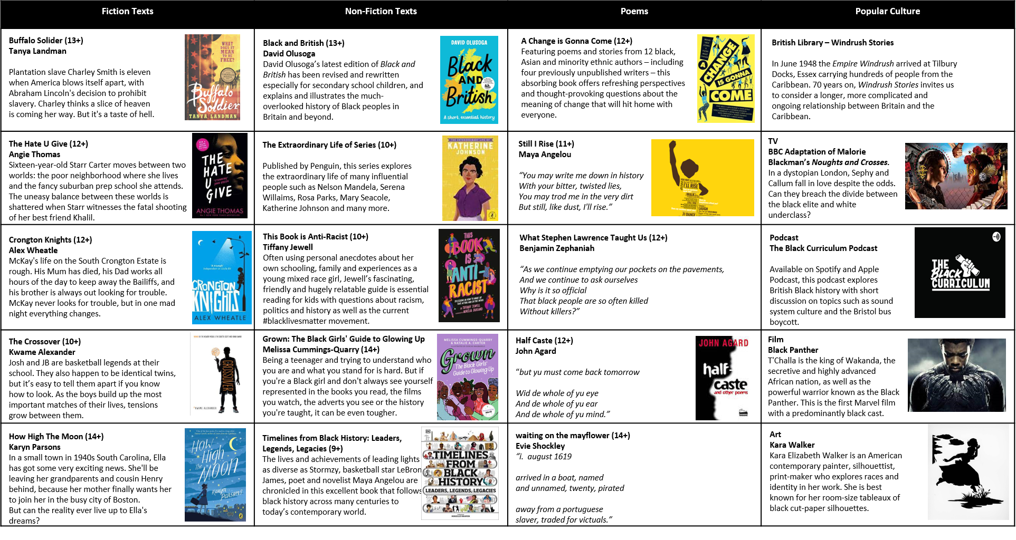
Black History Month 2021

